Slide 1

AdaBoost Regression Algorithm

Slide 2
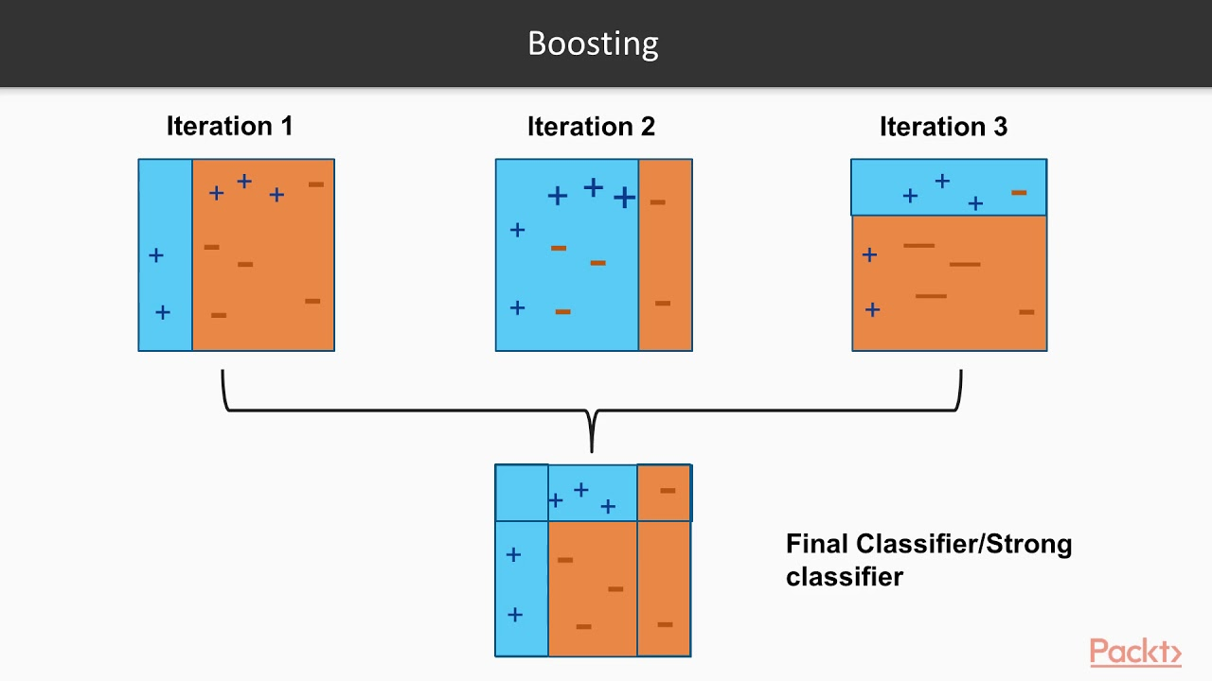
Introduction to AdaBoost Definition: AdaBoost (Adaptive Boosting) is a machine learning ensemble technique. Purpose: It combines multiple weak learners to create a strong predictive model. Application: Used for classification and regression tasks.

Slide 3
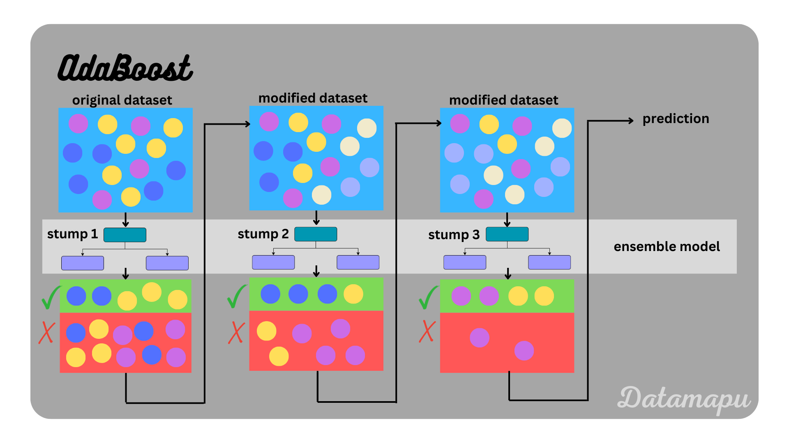
How AdaBoost Works
Weak Learners: Typically decision trees (stumps).
Weighting: Each learner is weighted based on its performance.
Iteration: Multiple iterations adjust weights to focus on harder-to-predict instances.
AdaBoost Algorithm Steps
Initialize Weights: Assign equal weights to all data points.
Train Weak Learner: Fit a weak learner to the data.
Evaluate Error: Calculate the error of the learner.
Update Weights: Increase weights for misclassified points.
Combine Models: Aggregate predictions from all learners

Slide 4

AdaBoost for Regression
Adaptation: Instead of focusing on misclassified points, it minimizes residuals.
Prediction: The final prediction is a weighted sum of predictions from weak learners.
Loss Function: Typically uses the squared error loss.
Advantages of AdaBoost
Robustness: Effective against overfitting with appropriate parameter tuning.
Flexibility: Can be used with various weak learners.
Improved Accuracy: Often outperforms single learners.

Slide 5
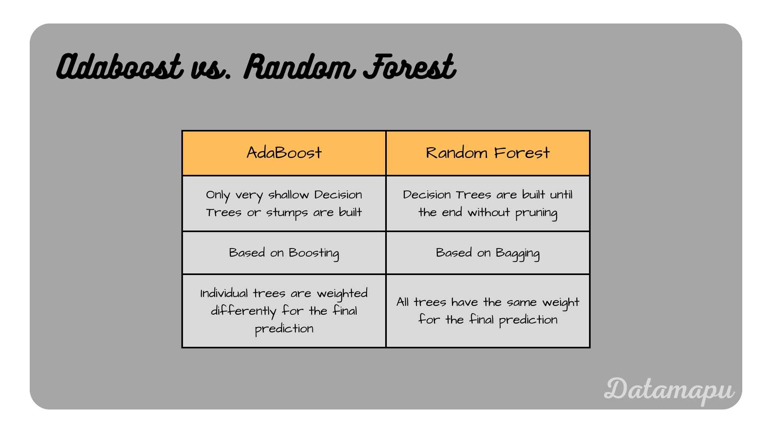
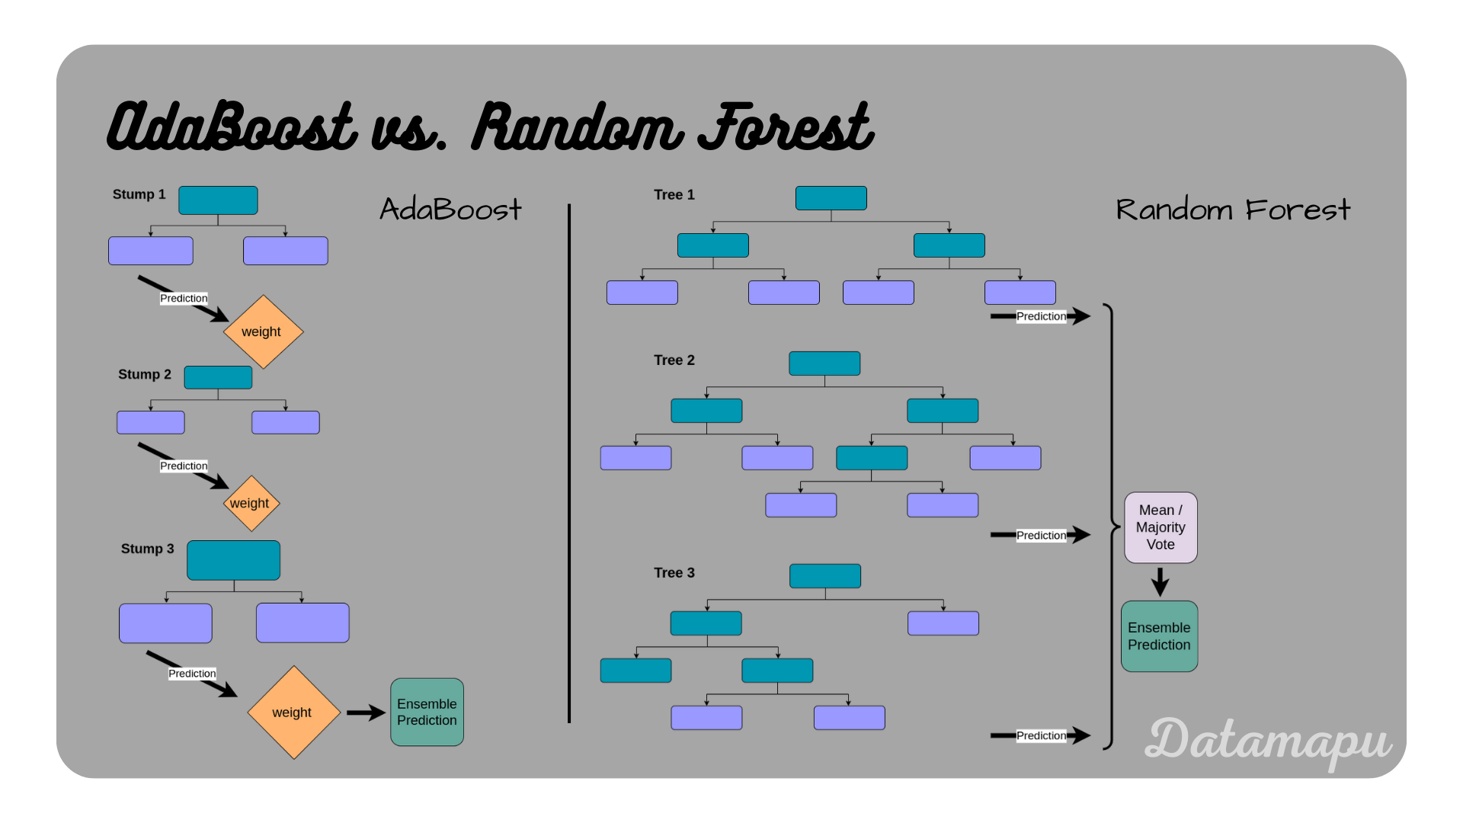

Slide 6
Disadvantages of AdaBoost
Sensitivity to Noisy Data: Can overfit if the data contains noise.
Computational Cost: More computationally intensive than simpler models.
Applications of AdaBoost Regression
Finance: Predicting stock prices.
Real Estate: Estimating property values.
Healthcare: Modeling patient outcomes

Slide 7
Implementation in Python
Libraries: Scikit-learn for easy implementation.
from sklearn.ensemble import AdaBoostRegressor
from sklearn.tree import DecisionTreeRegressor
model = AdaBoostRegressor(base_estimator=DecisionTreeRegressor(), n_estimators=50)
model.fit(X_train, y_train)
predictions = model.predict(X_test)

